Slide 1
New Interactions Project
(GSoC 2018 - Oppia)
Vibhor Agarwal
Notes:
Hi, I’m Vibhor, a Computer Science second year undergrad student from India. I’m part of this wonderful community, Oppia for over 10 months now. My GSoC project is ‘New Interactions’ project which aims at implementing two new interactions- ‘Number with units’ and ‘Drag and drop interaction’.

Slide 2
Project Goals
The ‘New Interactions’ project aims at implementing the two new interactions- Number with Units and Drag and Drop Sorting interaction.
These new interactions will help the learners in learning things more effectively.
Number with Units interaction will give better understanding of the units including SI, non-SI and currency units.
Drag and drop interaction will give better understanding of sorting the things with the help of easy drag and drop interface.
Notes:
Now, let’s throw some light on the goals of the project. Describe point 2. Then, point 3. As the name Number with Units suggests- ‘Number’ includes real as well as fraction values while Units can be SI, non-SI and currency units. Then, point 4.

Slide 3
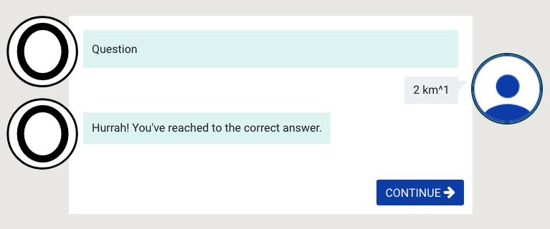

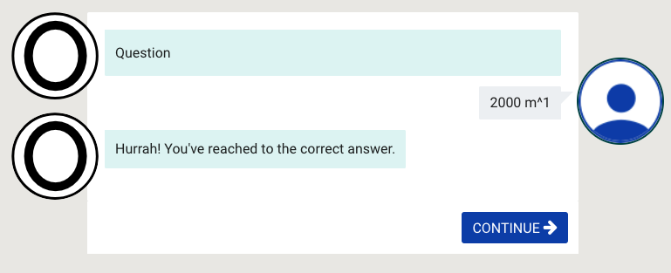
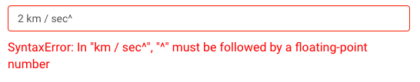
Mocks
Number with Units Interaction
Notes:
Here are the mocks for Number with Units interaction. 1. The first two mocks on the left shows the validation of the input given by the learner before answer submission. It validates invalid format for writing value and units. Technically, most of the unit validation is possible via ‘math.js’ library that checks for the correctness as well as syntax for writing the units [Explain both mocks]. In addition, the supplemental help table for writing the units is included so that the learner can refer in case he is stuck. 2. The two mocks on the right denote the verification of the answer submitted by the learner. Here, suppose that the lesson creator sets 2 km as the correct answer to the question. [Explain both the situations]. This is possible because of equivalency check of the units. Now, regarding the progress, this interaction is ready to be released in the upcoming July release. Only currency units are remaining to be implemented that I’ll be doing in milestone 3.

Slide 4
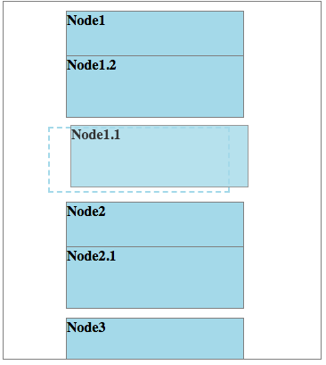
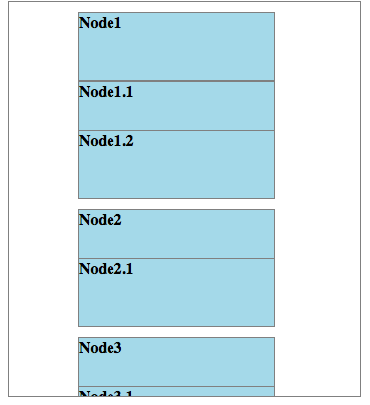
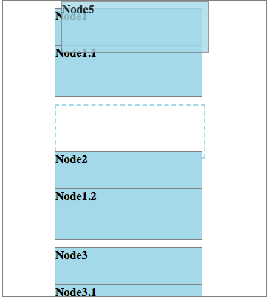
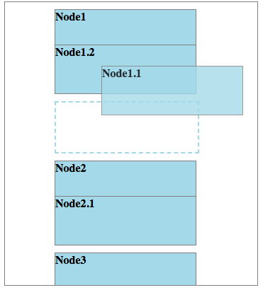
Drag and Drop Interaction
.
Notes:
Here are the mocks for Drag and Drop Sorting interaction. The learner can sort the items by dragging and dropping the tiles from top to bottom. In the first left mockup, the overlapping tiles denote that they can occupy the same position. For ex- ⅔ and 4/6 are equivalent fractions and will appear at the same position while sorting. It also supports automatic sorting.
As in mockup 2, when the tile is at the top or at the bottom most position, there will be automatic scrolling so that the learner can reach at the desired location even at the time of holding/dragging the tile.
The placeholder in mockup 3 guides the learner where will the tile be after being dropped. The independent placeholder slightly at left denotes the tile occupying the independent position 2 while placeholder in mockup 4 shows it will be at the first position overlapping the Node1. Regarding the progress of this interaction, most of the part is already implemented except few remaining rules for answer verification.

Slide 5
My Learnings
The most important thing is ‘project planning’ which includes mockups, making prior technical decisions and setting up timelines.
Brushed up Software Development skills and taught to consider all the edge cases and loopholes in the project priorly.
Delved deeper into the codebase and learnt to debug the code.
Wonderful and great learning experience of working with amazing people in the community.
Notes:
“Learning makes the man perfect”. So, it is very imp. to learn while doing things.
My current GSoC period is going on smoothly and I am learning a lot in this period.
The most important thing I am learning during GSoC’ 18 is project planning which is the most imp. part for the successful completion of any project. It includes mockups, making prior technical decisions and setting up timelines.
Points 2 and 3.
Last but not the least, I want to conclude that it is wonderful and great learning experience of working with amazing people in the community. Thank you and have a nice day!

